Slide 1
CSE322
Halting Problem of TM &
PCP
Lecture #39
Non Deterministic Turing Machines
&
Halting Problem of Turing Machine
&
Post Correspondence Problem

Slide 2
Decidability
When Turing Machine reaches at some final state it “HALTS”.
There are TMs that never halt on some inputs in any state.
So distinction between language can be made as:-
  TM that Halts on all input strings.
  Tm that never Halts on some input string.

Slide 3


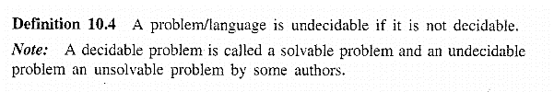

Slide 4
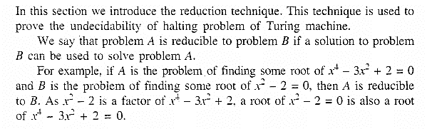

Halting Problem of Turing Machine

Slide 5
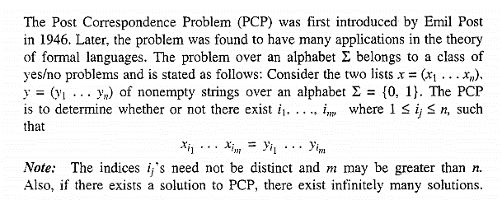
Post Correspondence Problem

